Slide 1





MariBelajar Activities Analysis
Powered by Merdeka Belajar and Microsoft
Yurham Afif
This Photo by Unknown Author is licensed under CC BY

Slide 2

Background
MariBelajar adalah sebuah startup di bidang pendidikan. MariBelajar berfokus pada bidang pendidikan berbasis teknologi informasi khususnya teknologi Microsoft. Baru-baru ini MariBelajar akan mengembangkan sebuah dasbor yang memanfaatkan kecerdasan buatan dan juga Power Platform untuk menjadi dasar perbaikan berkelanjutan dan rencana marketing kedepan.
This Photo by Unknown Author is licensed under CC BY-NC

Slide 3
Objective and Challenges
Objective
Challenges
Provides understanding about implementation of MariBelajar activities
Provides understanding about market segmentation of MariBelajar activities
Shows number and achievement of MariBelajar activities
Scattered data in tables
Unclean data
Limited statistics data
Data Source
Merdeka Belajar Kampus Merdeka (MBKM) – Microsoft

Slide 4
Data Understanding
Kegiatan Terlaksana di FY20.xlsx
No
Fiscal Year
Program
Event Name
Event Date
Segmen
Quarter
Total Peserta
Kegiatan Terlaksana di FY21.xlsx
No
Fiscal Year
Quarter
Tanggal Pelaksanaan
Durasi /Jam
Nama Kegiatan
Program
Segmen
Government Official
Non-Government Official
Total Peserta
Training Catalog.xlsx
2 tables (Kurikulum MariBelajar and Kurikulum MOOC)
Course ID
Title of Course
Topics

Slide 5
Data Preprocessing
Kegiatan Terlaksana
Change date format and strange date data correction
Trim data from white spaces
Split start and end `Tanggal Pelaksanaan`
Match `Program` and `Segmen` name from two tables
Regenerate `Quarter` label from `Tanggal Pelaksanaan`
Fill missing value of `Government Official` and `Non-Government Official` in ‘FY21’ data
Renaming column from two tables
Join two tables
Training Catalog
Split into two tables
Fill empty cells
Trim data from white spaces

Slide 6
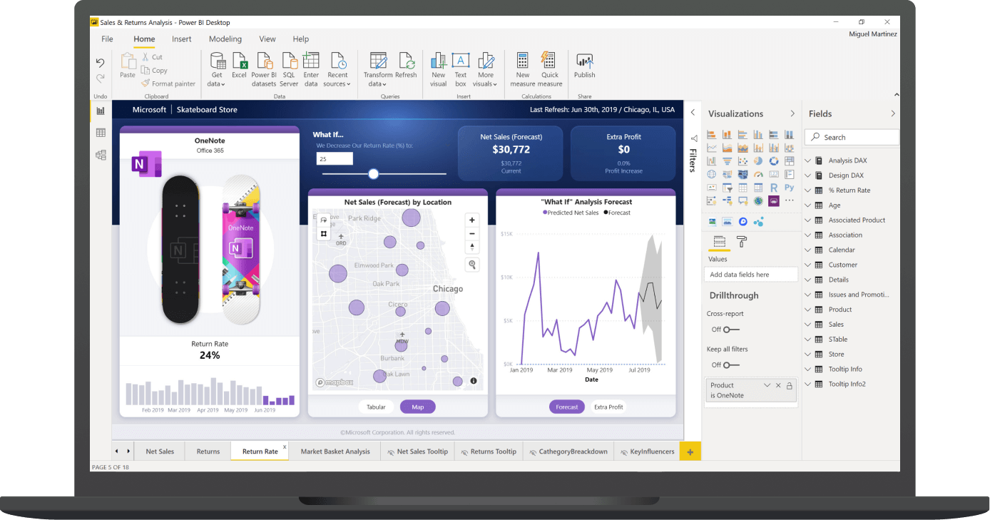
Data Mining and Visualisation
Using Power BI Desktop

Slide 7

Further Step: AI Integration
Language Detection
Extract Key Phrases
‘Kurikulum Maribelajar’ from 177 to 294 rows
‘Kurikulum MOOC’ from 127 to 238 rows
‘Kegiatan’ from 230 to 533 rows
Phrases in id is undetected somehow
Classification (lack in Azure ML services integration with Power BI Desktop) -> nextProject
Visualise data using
This Photo by Unknown Author is licensed under CC BY

Slide 8
Summary
MariBelajar has reached 16 thousand participants with 230 activities divided into 14 programs during the 2020-2021 fiscal year.
The user segments that are controlled are HigherEd and K-12, a special strategy is needed to reach other segments: Corporate and Professional. However, MariBelajar is quite capable of cooperating with government employees reaching 28.2% of the total participants in 2021.
Total Peserta for 2021 (8805) was higher than 2020 (7083), which is good.﻿﻿ 2021 accounted for 55.42% of Total Peserta.﻿﻿ ﻿﻿GTP in Segmen made up 27.89% of Total Peserta
MariBelajar's efforts to increase the number of participants in Q2 by increasing the types of activities do not seem to be successful because the trend shows that there are more participants in Q4.

Slide 9
Recommendation?
Create a variety of programs targeting the Professional and Corporate segments in Q4
Evaluation of activities running in Q2 because they are less promising
Programs with less than 10 participants, if not private classes, also need to be evaluated to avoid wasting resources

Slide 10



MariBelajar Activities Analysis
Powered by Merdeka Belajar and Microsoft
Yurham Afif
itsapep
This Photo by Unknown Author is licensed under CC BY

